Slide 1
Biol 7200: Programming for Bioinformatics Environments and installations

Slide 2
Live-coding
An annotated version of any planned live-coding will be made available on canvas
Impromptu live-coding in response to questions (and during demo discussions) will not be available on Canvas

Slide 3
Plan for today
What is an environment?
Why would I change my environment?
Why would I maintain multiple environments?
How can I install software globally vs in an environment?

Slide 4
Plan for today
What is an environment?
Why would I change my environment?
Why would I maintain multiple environments?
How can I install software globally vs in an environment?

Slide 5
What is an environment?
“When a program is invoked it is given an array of strings called the environment. This is a list of name-value pairs, of the form name=value.”
https://www.gnu.org/software/bash/manual/html_node/Environment.html

Slide 6
Name-value pairs? Those are variables (and aliases)
Variables and aliases are values that are assigned to names (a string of characters).
They behave differently and have different uses:
Variables store data
Aliases serve as command shortcuts (bash executes the value of the alias)

Slide 7
Variable and alias creation, retrieval
Variables are assigned and used like this (N.B., no whitespace around “=“!)
Create: <variable_name>=<value>
Use: <command> $<variable_name>
View: echo $<variable_name>
Aliases are assigned (and viewed) using the alias command
Create: alias <alias_name>=<command_plus_options_etc>
Use: <alias_name>
View: alias <alias_name>
Remove with unset and unalias

Slide 8
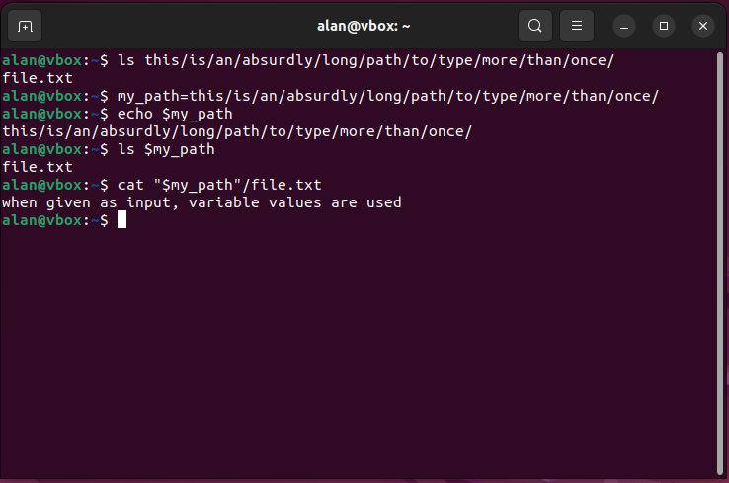
Why use variables?
Save yourself typing things out
Name paths to help keep them straight in your head
Named variables in commands are easier for someone else to read and follow
Variables can store values during loops (more on this another day)
Some variables are used to control shell behavior

Slide 9
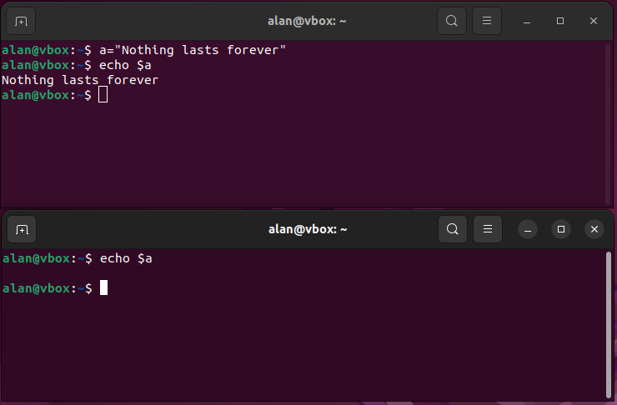
Variables are only available in your current env
Try it yourself:
Start a terminal
Create a variable
echo the variable and see its value
Start a new terminal
echo the variable and see no value

Slide 10
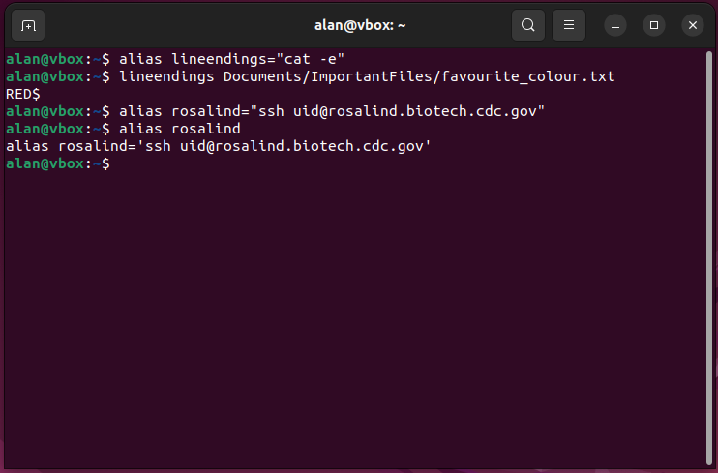
Why use aliases?
Aliases store values like variables, but their contents are interpreted as Bash code
Use these as command shortcuts for long commands or commonly used option combinations
Your environment likely contains default aliases
View aliases in your environment with alias -p

Slide 11
Plan for today
What is an environment?
Why would I change my environment?
Why would I maintain multiple environments?
How can I install software globally vs in an environment?

Slide 12
What does the environment affect?
An environment is the set of variables and aliases that are loaded when a program (like your shell) is started
You can add new variables and aliases to an environment
Variables and aliases only exist within the scope of the environment in which they are created (or loaded on startup) – the value of variables and aliases can differ between environments
Variables are used by commands you run – contents determine behavior

Slide 13
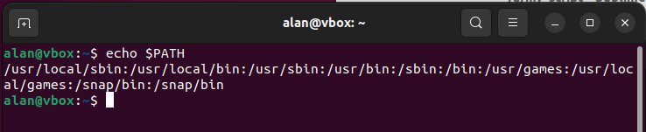
$Path determines where your shell looks for programs
$PATH is a variable containing a colon-delimited list of directories with executable programs
When you issue a command, your shell checks these directories until it finds the program you called
The order of directories in the $PATH is the order they are checked. First executable found is run.

Slide 14
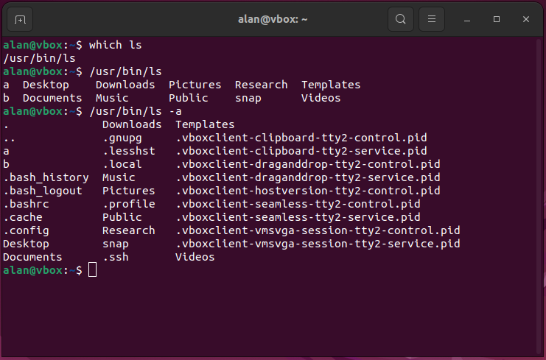
Which executable does your shell run?
which returns the path to executables that are run when issuing commands
These executables can also be called directly using their path
Calling executables like this is functionally the same

Slide 15
How can we get the shell to find new executables?
Your shell searches the directories in your path for an executable matching issued commands
If your executable is not in one of those directories it won’t be run
2 solutions:
Put your executable in a directory in your $PATH
Add your executable’s location to the $PATH

Slide 16
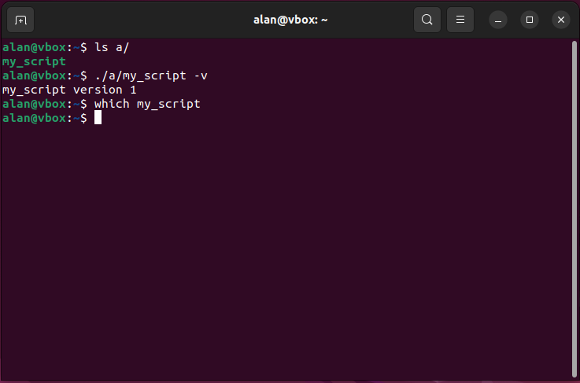
Adding a directory to your $PATH – setting up

Slide 17
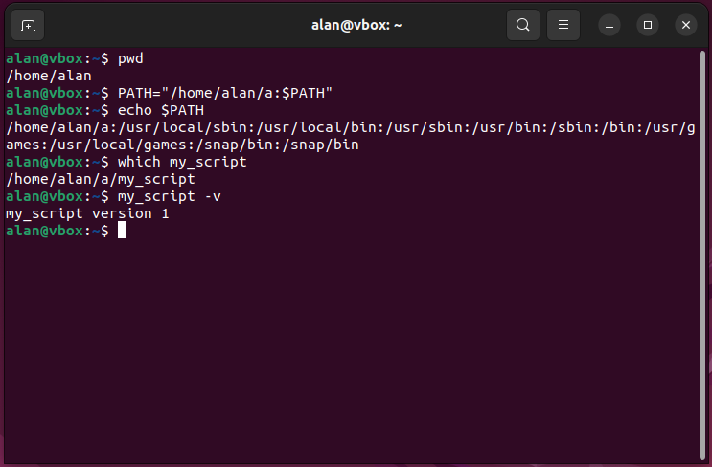
Adding a directory to your $PATH – adding the dir

Slide 18
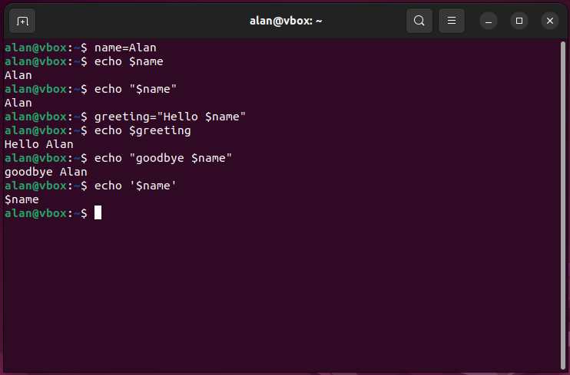
How did that work? variable expansion
A.K.A. “variable substitution” or “string interpolation”
Variables within strings are replaced with their values
Note characters with single quotes (‘ ‘) are interpreted literally (e.g., $ doesn’t indicate a variable)

Slide 19
Use variable expansion to add to variables

Slide 20
How is the environment initialized?
For bash sessions, one of two files are executed when starting your terminal:
For login shells (i.e., you sshed or otherwise logged in - Mac) “~/.bash_profile” is used
For non-login shells (e.g., local sessions – WSL, Ubuntu) “~/.bashrc” is used
Additionally, other files can be executed by the “.bash_profile” or “.bashrc”
E.g., you can make an aliases file called “.bash_aliases” to keep all your aliases in one place
Changes to these files change all future shell environments
Let’s take a look at “.bashrc” in a demo…
N.B. Make a backup of the files before you change them!!! Changes can’t be undone!!!

Slide 21
Optional viewing: Customizing your prompt
Corey Schafer – Customize your terminal
BACKUP DOTFILES BEFORE MESSING WITH THEM!!!
Notes:
Also consider PROMPT_DIRTRIM=N where N is the number of directories shown before your prompt. It helps with long prompts.

Slide 22
Source and export load and emit variables
source runs a script using your current shell – all variables are retained
Could think of it as importing variables from the script
export declares variables that are passed to any subshells (not parent shells)
When you run a command or script, that is run in a subshell
It only has access to variables that were exported
Demo

Slide 23
Plan for today
What is an environment?
Why would I change my environment?
Why would I maintain multiple environments?
How can I install software globally vs in an environment?

Slide 24
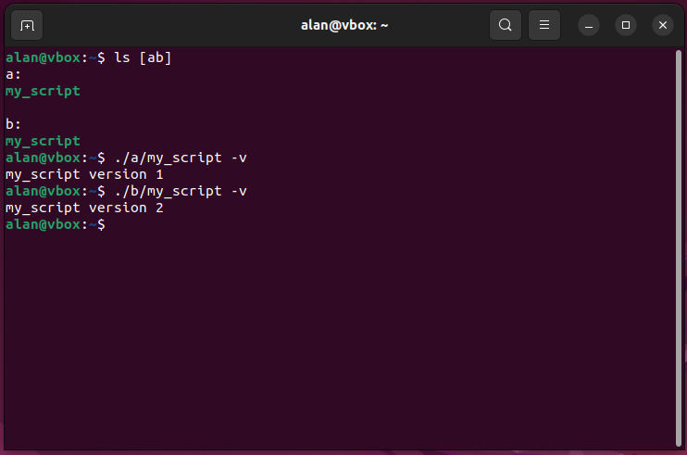
what if you have two versions of the executable?

Slide 25
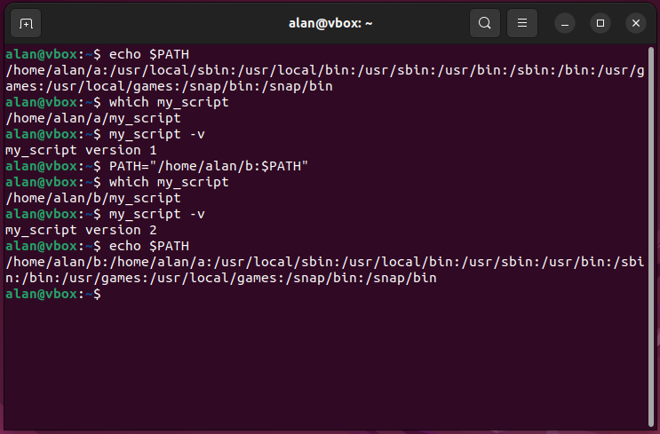
Your shell uses the first executable it finds in the PATH

Slide 26
Why have different versions of the same thing?

Slide 27
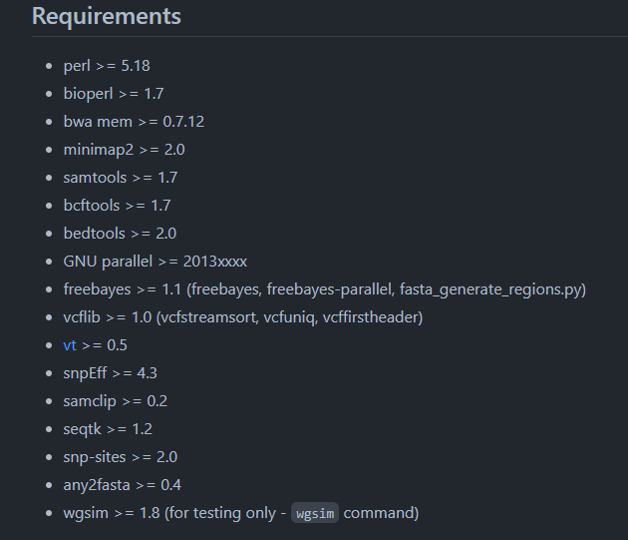
Bioinformatic tools often have dependencies
https://github.com/tseemann/snippy

Slide 28
Plan for today
What is an environment?
Why would I change my environment?
Why would I maintain multiple environments?
How can I install software globally vs in an environment?

Slide 29
Global installations (manual)
Download an executable/script
Then either
Install for everyone – usually not best option (requires sudo privileges)
Put the software in a dir on all users’ $PATH (e.g., /bin/)
Or (much better option)
Install just for you – keep your personal installations separate
Make a “~/bin/” dir
put the software in there
add ~/bin/ to your $PATH in your “.bashrc”

Slide 30
Global installations (automatic)
Ubuntu (and other Linux distributions) have a package manager: apt and apt-get
Core Linux software and major packages available
Handles installation and update (not auto-update)
Requires sudo
Common commands:
Install or update package(s) sudo apt install <package> …
Update database of available packages (and versions) sudo apt update
Upgrade installed software to latest version sudo apt ugrade

Slide 31
Creating environments to separate installations

Slide 32
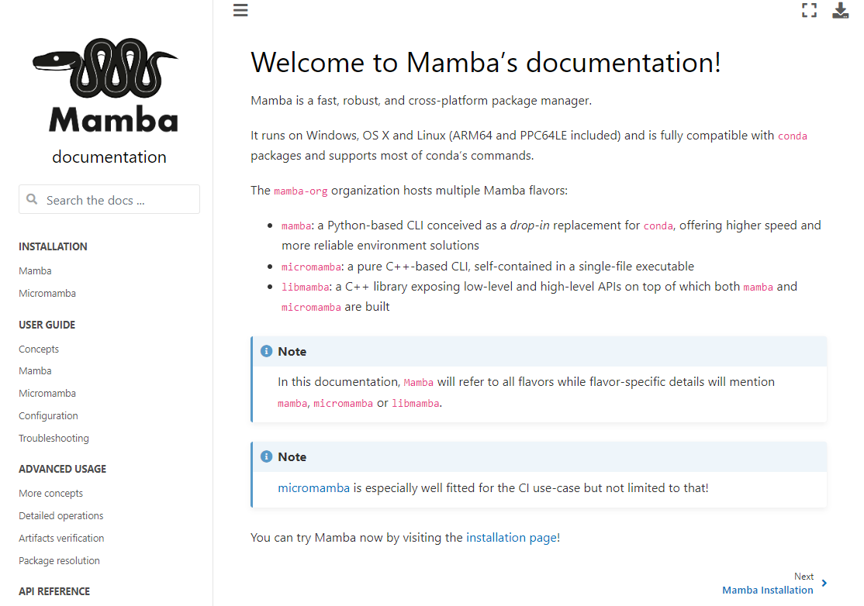
Mamba (improved conda) is an environment manager

Slide 33
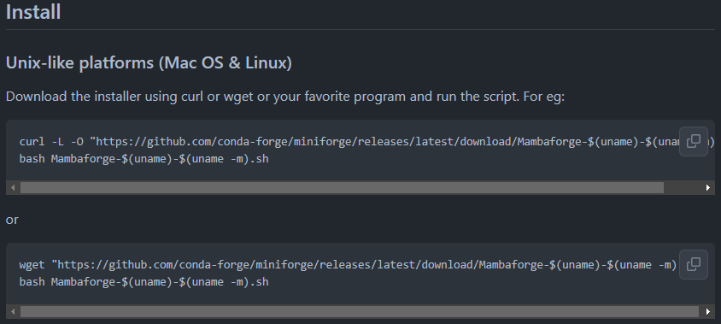
Installing mamba
https://github.com/conda-forge/miniforge#install
Note: 2 main commands to download things from the internet. wget and curl
Equivalent for many tasks
Differences (as described by curl developer) https://daniel.haxx.se/docs/curl-vs-wget.html
If interested, curl developer is streaming a tutorial on twitch next week https://daniel.haxx.se/blog/2023/08/08/mastering-the-curl-command-line/
Demo
Notes:
curl -L -O "https://github.com/conda-forge/miniforge/releases/latest/download/Mambaforge-$(uname)-$(uname -m).sh"
bash Mambaforge-$(uname)-$(uname -m).sh OR wget "https://github.com/conda-forge/miniforge/releases/latest/download/Mambaforge-$(uname)-$(uname -m).sh"
bash Mambaforge-$(uname)-$(uname -m).sh Then hit enter to proceed through license agreement and accept all defaults by typing yes and hitting enter when prompted with a yes/no question

Slide 34
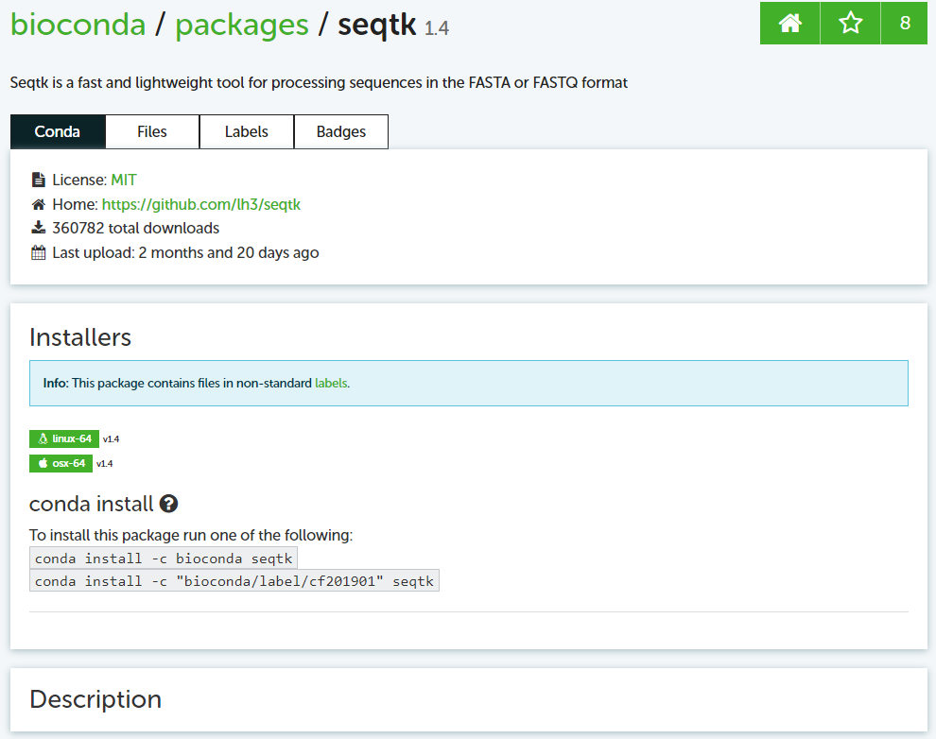
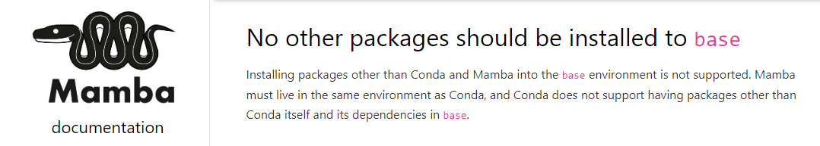
Installing software with mamba
Find the software on anaconda.org
Replace the word “conda” with “mamba” in the install command shown
Install in desired environment (NOT IN BASE!)

Slide 35
Mamba usage
Action | Command
Create environment | mamba create -n <name> [-c <channel>] [<package>[<version>] …]
Activate environment | mamba activate <env>
Deactivate (leave) environment | mamba deactivate
Install software in current environment | mamba install [-c <channel>] [<package>[<version>] …]
Remove software from current environment | mamba remove [<package> …]
Update software to latest compatible version | mamba update [<package> …]
List software in environment | mamba list [<regex>]
List environments | mamba env list
Delete environment | mamba env remove -n <name>
Export environment to file (platform agnostic) | mamba env export –from-history –o <filename.yaml>
Import environment from file | mamba env create -n <name> --file <yaml.filename>

Slide 36
Questions from today or last week?

Slide 37
End of Lesson

